Slide 1
VIETNAM FAMILY TOURS
Our beautiful S-shaped Vietnam country is proud to own the great diversity of natural resources from the magnificent Halong Bay with thousands of limestone islands to the most desired white sand beaches stretching along our seashores with Nha Trang, Danang, Mui Ne, or the isolated and lovely Phu Quoc Island. Besides, Vietnam is famous with the authentic minority hill tribe villages living in the Northern West mountainous areas like Sapa, Ha Giang, etc. Exploring a Vietnam nation with the long-aged history and cultural tradition, from Hanoi Capital with the busy Old Quarter to peaceful Hoi An Ancient Port Town; from tranquil Hue Ancient Capital to the bustling Ho Chi Minh City (formerly called Saigon).
SUGGESTED ITINERARY
Vietnam is a perfectly charming and promising country for your amazing and unforgettable family holiday, and our private family tours offer an easy and flexible pace tailored for every family from all over the world. We go above and beyond in delivering family holidays that meet all the desires of your small kids or your teenager – aged children, your spouse or your partner, your parents, etc. Vietnam family tours are designed to bring the generations in your family closer together with the first-class entertainment, exciting outdoor sightseeing activities & so much more. All together make your family holiday being the most amazing, the most exciting, and the most meaningful. You love your family, and we do love serving your family at our best capability!

Slide 2
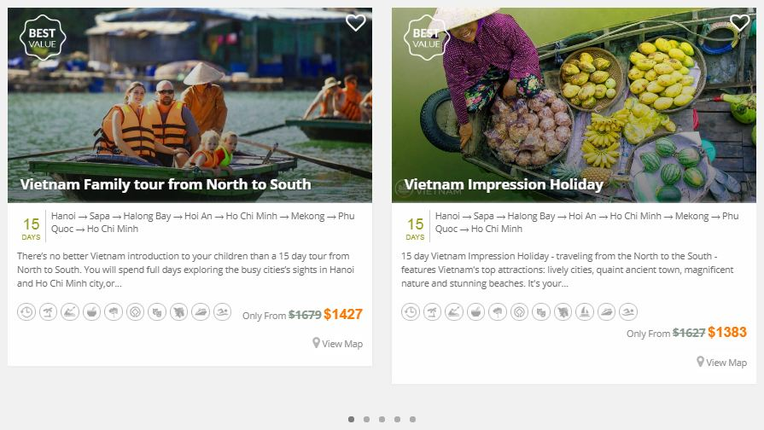

Slide 3

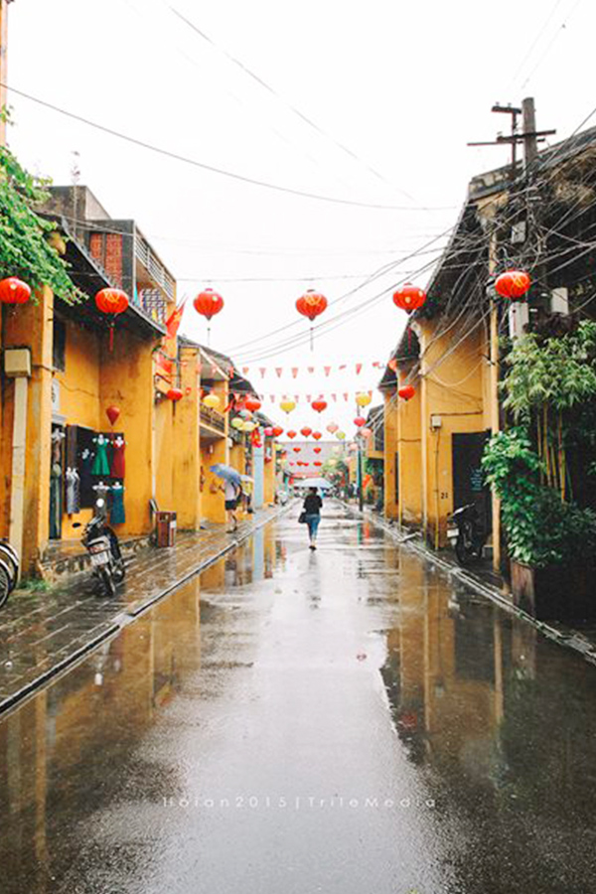
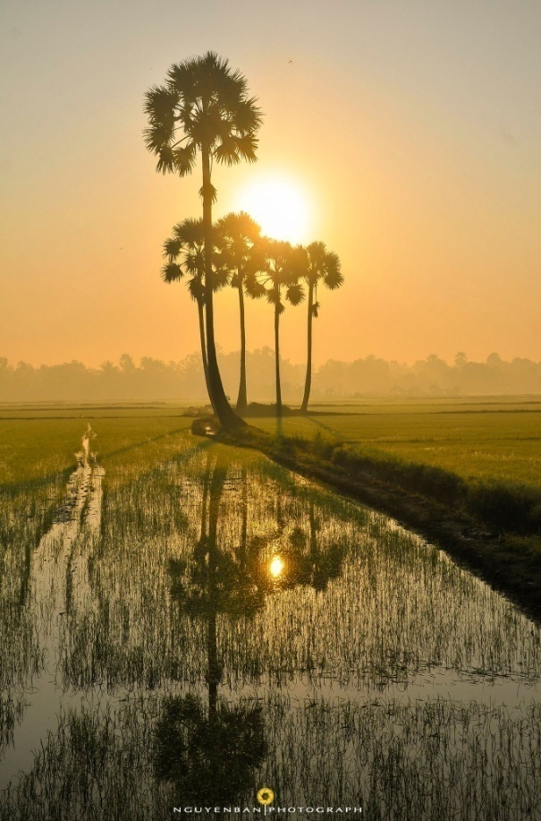
When to visit Vietnam with Kids
Northern Vietnam Weather
Central
Vietnam Weather
South Vietnam Weather
Northern areas are good to visit year-round, but keep in mind that winters are rather cold especially in the mountainous regions such as Sapa & Ha Giang, summers are quite hot and have high humidity, remember to bring your jackets, sunscreen & a hat to protect you and your kids from the sun. From May to September, please be aware this is the rainy season, landslides on the roads to both Sapa & Ha Giang frequently happen & easily lead to accidents.
In general, the best time for Family with Kids visiting Vietnam is Springs which lasts from February to April & Autumns from August to October. In these months, the temperatures are general pleasant & rainfall is lighter. You still can travel to central parts in summers but do not forget to bring sunscreen with you.
There are two main seasons which are Wet Season (May to October) & Dry Season (November to April) in the Southern regions. As the rains are usually short & won't affect your excursion, you can visit and witness the beauty of this region on any day of the year.
https://www.nomadicmatt.com/travel-guides/vietnam-travel-tips/#top5

Slide 4




Getting around with Kids in Vietnam
Vietnam on Foot
Your family can find it easy to walk over the streets of Vietnam since much of Vietnam is walkable. If you are going to spend much time walking, taking a baby carrier with you is the best decision.
TIP: Many tourists are scared of the most insane traffic in the big cities such as Hanoi or Ho Chi Minh (Saigon) when they cross the crazy teeming streets when there is no crosswalk (some streets have but most Vietnamese rarely use them), no pedestrian signals and a swarm of motorcycles does not seem to stop. The best way to cross is raising your hands to let the drivers know & starting to walk with deliberate steps, don't act indecisively & remember to keep your kids close.
Private Transfer
The easiest way to transfer in the city or from city-to-city in a flexible way is transferring by the private car at a reasonable price. The friendly & professional driver not only picking you up at your desired location and dropping you off at your final destination, but he/she can also stop as request along the way to let you take some photos & relax.
Motorcycles in Vietnam
Since the main transportations of Vietnamese are scooters & motorcycles, you can rent for them all over the country (From North to South). Choose the reliable stores and check everything before sign especially inspect either the scooter or motorcycle in question, take photos of any dents or scratches.
NOTE: If you do not have a Vietnam or a valid license, you should not rent a scooter or motorcycle as if you have an accident, you will be the one who gets in trouble (with both traffic police & your insurance company) though the other party was at fault. You can take the motorbike tour which will bring you the best feeling while sitting behind the back of the professional driver & enjoy the city at the same time.
Buses in Vietnam
Please be aware that Vietnamese buses usually do not have the usable toilets & are rather cramped with Western standards since they are designed for the average Vietnamese height.

Slide 5



Trains in Vietnam
Many families love taking the train in Vietnam because of its safety, affordable prices & comfortable services. Although some routes such as from Hanoi to Ho Chi Minh or vice versa might be slow, you will have a precious chance to witness the stunning views of the Vietnamese countrysides.
Flights in Vietnam
With the total area of over 300,000 km2, everyone might be surprised that Vietnam is home to more than 20 airports. By far, the most international flights arrive in Hanoi (the capital of Vietnam - located in the North of Vietnam) & Ho Chi Minh City (Saigon) (one of the biggest city in Vietnam - situated in the South); some international flights land in Danang & the seaside town of Nha Trang also. If you can spend only a short time to travel in Vietnam, taking some internal flights to travel city-to-city will be the best option to save more time for discovering this country.
Taxis & Cyclos in Vietnam
Taxis are usually very cheap at Vietnam (Rates start at about 12,000 VND (less than 1 USD) /kilometre). However, you should only choose reliable brand taxis (Mai Linh, Thanh Cong & Taxi Group in Hanoi; Vinasun, Mai Linh in Ho Chi Minh City) to avoid the scams like over-paying or ending up at the different location.
The same problem as Taxis, before hopping any Cyclo, you should beware of charming cyclo driver & remember to ask for the price first & try your luck at bartering.

Slide 6

The most attractive destinations for Vietnam Family Tours
Hanoi
Situating in the centre of the North, Hanoi, a thousand-year capital attracts visitors coming to explore the city with various interesting activities. From cultural understanding journeys to iconic sites to delightful cyclo trips in bustling Old Quarter or tempting traditional cooking classes, all will make sure your family tour could not be more fascinating.
Attractions:
Ho Chi Minh Complex
Temple of Literature
Hoan Kiem Lake
The Old Quarter
The Museum of Ethnology
Local shows for parents & kids:
Water Puppet Show
My Village Show
Ionah Show
The Quintessence of Tonkin Show
Suggestion for Family activities:
Take a cyclo tour to witness the daily life of locals
Bike to Duong Lam Ancient Village
Visit Bat Trang Village, and challenge your kids with the skills to make ceramic souvenirs
Visit Van Phuc Silk Village
Enjoy a walking food tour around the Old Quarters
Take an electric car tour around the West Lake
Shopping or Entertainment Centers for Family in Vietnam:
Traditional products: 36 commodity streets in Hanoi Old Quarters
Markets: Night Market, Dong Xuan Market
https://www.nomadicmatt.com/travel-guides/vietnam-travel-tips/#top5

Slide 7

Sapa
Nestled in the majestic Hoang Lien Son Moutain Range with mild weather all year round, Sapa is an ideal place that your family could spend short trips admiring the dramatically spectacular scenery of mountainous landscape and exploring distinctive local life in upland which is indeed attractive and colourful.
Attractions:
Cat Cat, Sin Chai, Lao Chai, Ta Van, Ma Tra & Ta Phin villages
Silver & Love Waterfalls
Bac Ha Market
Fansipan Mountain
Holy Rosary Church / The Stone Church
Local shows for parents & kids:
Quang Truong Spare: watch dancing and singing by the locals
Suggestion for Family activities:
Experience overnight stay at a local homestay
Exchange culture with local hosts
Visit local schools with charity works and gifts

Slide 8

Halong Bay
Renowned all around the world by the exceptional natural beauty created from karst formation over the sea, Halong Bay is a should-not-miss destination in each Vietnam trip. Setting off an excursion to Halong Bay, your family will have a chance to experience overnight cruises with various activities for sightseeing and exploring the Heritage Site.
Attractions:
Surprise Cave (Dong Sung Sot)
Heavenly Palace Cave (Dong Thien Cung)
Dau Go Cave
Trung Trang Cave
Quan Y Cave
Luon Cave
Ti Top Island
Islands in Halong Bay
Islands in Bai Tu Long Bay
Islands in Lan Ha Bay
Suggestion for Family activities:
Kayaking in the bay
Swimming
Boat rowing
Biking in Viet Hai Village
Sunbathing on cruise sundeck

Slide 9

Ninh Binh
With only two hours of driving from Hanoi and many natural landscapes as well as historic sites, Ninh Binh is an ideal destination for a great family tour with kids. Biking through immense rice paddies, boating to Tam Coc and Trang An, visiting temples and pagodas, kids would love to join all and they definitely enjoy the best time in Nothern Vietnamese countryside.
Attractions:
Trang An Grottos – the studio of the new King Kong Movie
Tam Coc Caves
Hoa Lu Ancient Capital
Cuc Phuong National Park
Van Long Nature Reserve
Bai Dinh Pagoda
Kenh Ga Hot Spring
Suggestion for Family activities:
Go camping in Cuc Phuong National Park, overnight in the park
Take a boat at Trang An, Tam Coc or Van Long
Cycle through the rice terraced fields
Enjoy hot spring bath at Kenh Ga Hot Spring

Slide 10

QUANG BINH
Quang Binh is one of the newest attractive destinations on overseas tourists' maps because of its incredible mountainous landscapes, stunning beaches, the most outstanding caves such as Son Doong Cave, Hang En Cave, Thien Duong Cave (Paradise Cave) & Phong Nha Cave. Besides a wide variety of adventure & fun activities for both adults & kids, Quang Binh is also a perfect place to gain an insight into Vietnam's bloody past.
Attractions:
In Dong Hoi City: Mother Suot Statue, Tam Toa Church, Dong Hoi Market
In Phong Nha: Phong Nha Cave, Son Doong Cave, Paradise Cave, En Cave, Dark Cave, Tu Lan Cave, Pygmy Cave, Elephant Cave & Tien Cave
Beaches:
Nhat Le Beach
Suggestion for Family activities:
Explore Dark Cave & join in some interesting activities such as Zipline, Kayaking on Chay Cave & Mud Bath
Take a boat upstream the Son River & visit Phong Nha Cave
Relax on stunning Nhat Le Beach
Visit the special Duck Farm
Improve your knowledge about Vietnam history
Cycle along the pure Son River in the morning
Enjoy the authentic Vietnamese food

Slide 11

Hue
Great for history buffs and culture enthusiasts, Hue city is among the top must-visit destination for tourists who get into exploring the age-old traditions and the last feudal dynasty in Vietnam with the famous Imperial Citadel. This ancient city also provides natural and countryside excursions in different ways such as walking, biking or boating.
Attractions:
Imperial Citadel
Hue Museum of Royal Antiques
Tombs of Nguyen Dynasty’s Kings: Minh Mang, Khai Dinh & Tu Duc tombs
Perfume River
Thien Mu Pagoda
Beaches:
Lang Co Beach
Thuan An Beach
Local shows for parents & kids:
Cruising on the romantic river - Huong River, across the capital city of Hue. Relax and pamper yourself in this leisure boat trip, and listen to traditional folk songs.
Having dinner at a local restaurant with the performance of Hue Royal Court Singing
Watching Martial Arts Performance
Suggestion for Family activities:
Bike to Thanh Toan Village in the countryside
Make paper flowers at Thanh Tien Village
Relax & have fun at Alba Hot Springs
Go hiking and camping in Bach Ma National Park

Slide 12

Hoi An
Nestled alongside the romantic Thu Bon River, Hoi An Ancient Town is one of the best destinations in Vietnam to discover the fusion of cultures where East meets West. Popular but less chaotic, this sweet town is also an ideal place for leisure travel with charming cuisine, quaint streetscapes and peaceful countryside.
Attractions:
In the town centre: Quan Cong Temple, Phuc Kien Temple, Tan Ky Ancient House, Phung Hung house, Japanese Bridge
In the countryside: Tra Que Vegetable Village, Tra Nhieu & Van Lang Fishing Villages, Thanh Ha Pottery Village, Kim Bong Carpentry Village, Cam Thanh Water Coconut Village
Beaches:
An Bang Beach
Cham Islands (Cu Lao Cham)
Cua Dai Beach
Local shows for parents & kids:
Listen to Bai Choi singing in Hoian ancient town in the evening, join in the games with the local performers
Hoi An Impression Show
A O & Palao Shows
Suggestion for Family activities:
Bike to the countryside for sightseeing
Take a boat trip on Thu Bon River
Try basket boat rowing and fishing in the water coconut forest
Experience overnight stay at a local homestay in the countryside
Challenge yourselves as a local farmer
Join in a traditional cooking class
Challenge your kids’ ability to make lanterns

Slide 13

Nha Trang
When it comes to Nha Trang, this city is famous as the best destination for plenty of outstanding beaches, water sports & tropical islands along the coast of South Central Vietnam. Your kids will definitely have so much fun by building some cool sandcastles while you soak up the rays of sunshine & relax.
Attractions:
Nha Trang Beach
Po Nagar Cham Towers
National Oceanographic Museum
Nha Trang Cathedral
Long Son Pagoda
Hon Chong Promontory
Mun Island
Tam Island
Van Phong Bay
Ninh Vay Bay
Diep Son Island
Dam Market
Local shows for parents & kids:
Nha Trang Water Puppet Show
Music Show With Local Bamboo Instruments
Local Folk Dance Show at Po Nagar Towers
Suggestion for Family activities:
Participate in a variety of sea sport activities such as scuba diving, snorkelling, surfing, body boarding, jet skiing & parasailing
Play games in Vinpearl Land Nha Trang Amusement Park
Take the adventure rafting tour on Cai River
Enjoy cruise sailing in Nha Trang Bay
Enjoy swimming & go fishing

Slide 14

Mui Ne
Mui Ne is an ideal retreat with the unique geographical wonders such as the Fairy Stream, the Red and White Sand Dunes; idyllic fishing market and villages, and charming Cham ancient structures. This coastal town is also one of the best places in Asia to enjoy water sports like kiteboarding and windsurfing.
Attractions:
Mui Ne beach
Sand Dunes
Po Shanu Cham Towers
Fairy Spring
Mui Ne Market
Phuoc Thien Pagoda
Phu Quy Island
Ke Ga Cape
Suggestion for Family activities:
Take Mui Ne sand dunes jeep car tour
Witness Mui Ne scenery from Hoi Air Balloon
Join in different sea sport activities such as windsurfing, sailing, snorkelling & kite surfing
Try basket boat rowing
Go fishing
Visit Ke Ga Light House

Slide 15

Ho Chi Minh City
Ho Chi Minh City (HCMC, formerly Saigon) is well-known as the biggest hustle & bustle city in Vietnam with approximately 8.6 million people (2017). This is where you & your kids will enjoy the most diverse cuisines, visit some historic attractions like the maze-like Cu Chi Tunnels & Presidential Palace & bustling markets such as Ben Thanh Market & Chinatown.
Attractions:
In the city centre: Presidential Palace, The War Remnants Museum, Old Post Office, Chinatown and Binh Tay Market, The Notre Dame Cathedral, Ben Thanh Market
In the countryside: Cu Chi Tunnels, Can Gio National Park
Local shows for parents & kids:
A O Show, Teh Dar Show & The Mist Show at the city’s Opera House
Water puppet show
Suggestion for Family activities:
Visit Botanical Garden
Take eco-tourism tour to discover Can Gio National Park
Shopping or Entertainment Centers for Family in Vietnam:
Markets: Ben Thanh Market, Chinatown, Binh Tay Market, An Dong Market

Slide 16

Mekong Delta
This is the most unique destination in Vietnam where shows you a way of life depending on upstream waters that have continued unchanged for hundreds of years. Coming to this place & having many unforgettable experiences when visiting the colourful floatings markets, fruit orchards & learning how to make their traditional products.
Attractions:
Cai Be Floating Market
Cai Rang Floating Market
My Tho
Ben Tre
Tra Su Bird Sanctuary (Chau Doc)
Local shows for parents & kids:
Enjoy traditional fork songs “Don Ca Tai Tu”
Suggestion for Family activities:
Experience stay at a local homestay as bungalows on the water
Discover colourful fruit orchards
Row sampan boat through the small canals and creeks
Visit the local workshops in trade villages along the river banks
Bike in the villages
Take a ride on an ox-cart in the villages
Take a day boat trip or an overnight boat trip on the Mekong River

Slide 17

Phu Quoc
If you’re looking for a place in Vietnam to relax and enjoy sun-sand-sea, Phu Quoc, Vietnam’s the largest island, is truly a tropical paradise for your trip. With favourable natural conditions, Phu Quoc possesses not only alluring sandy beaches, calm turquoise water but also a vast of fresh seafood and fascinating watersports for your family to enjoy.
Attractions:
Long Beach
Star Beach
An Thoi Islands
Finger-nail Island – the paradise beach like the Maldives
Dinh Cau Temple
Cao Dai Temple
Phu Quoc Night Market
Suggestion for Family activities:
Play games in Vinpearl Land Phu Quoc Amusement Park
Try different types of sea sports like snorkelling to see the corals, kayaking, jet-skiing, kite surfing, surfing, body surfing, and skimming, sailing, parasailing
Biking alongside the stunning beaches
Visit fishing villages like Ham Ninh, Cua Van, Ganh Dau, Rach Vem, Rach Tram
Visit fish sauce making factories
Explore Finger-nail Island – the beach paradise
Enjoy the cable car to Pineapple Island

Slide 18
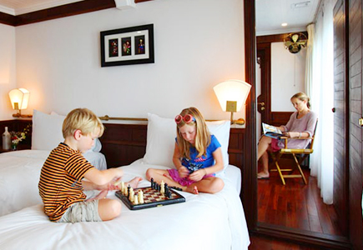
Where to stay in Vietnam for Family with Kids?
It can be tough planning a holiday when you've got little kids to please. That's why we've put together a great selection of family tours to Vietnam.
Hotel rooms to be chosen are totally suitable for your family use.
They are connecting rooms or a duplex family room for parents and children, making your stay just like at a home away from home; it is so cosy and comfortable to enjoy.
The accommodation might be a large beach villa with 02 – 03-bed rooms fitting a small family with kids or a big family with kids and grand mum and dad.
Little ones are sorted with everything from Baby Lounges to action-packed kids’ clubs, while teens have their own zone. Mum and dad can grab a coffee or sign up for a yoga class, and grandparents can relax by the pool. The accommodation is just right with kids' clubs, swimming pools perfect for splashing around in and buffet spreads with plenty of choices for picky eaters.
Hanoi
Sapa
Halong Bay
3-Star Gondola Hotel
4-Star Tirant Hotel
5-Star Sofitel Metropole Hotel
3-Star Sapa Dragon Hotel
4-Star Sapa Legend Hotel
5-Star Silk Path Grand Hotel
Halong Bay
3-Star Glory Cruise
4-Star Pelican Cruise
5-Star President Cruise
Lan Ha Bay (the South of Halong Bay)
4-Star Peony Cruise
5-Star Orchid Cruise
Bai Tu Long Bay (the North of Halong Bay)
3-Star Swan Cruise
4-Star Huong Hai Sealife Cruise
5-Star Signature Cruise
Ninh Binh
Hoi An
3-Star Tam Coc Ricefield Resort
4-Star Ninh Binh Legend Hotel
5-Star Emeralda Ninh Binh Resort Spa
3-Star Kim An Hotel & Spa
4-Star Vinh Hung Riverside Resort & Spa
5-Star Hotel Royal Hoi An - MGallery by Sofitel

Slide 19
Hue
Nha Trang
Mui Ne
3-Star Romance Hue Hotel
4-Star Hotel Saigon Morin
5-Star BWP Indochine Palace Hotel
3-Star Asia Paradise Nha Trang Hotel
4-Star Liberty Central Nha Trang Hotel
5-Star Mia Resort Nha Trang
3-Star Tien Dat Resort & Spa
4-Star The Cliff Resort & Residences
5-Star Sealinks City Hotel, Resort & Golf
Quang Binh
Ho Chi Minh
Mekong Delta
3-Star Phong Nha Lake House Resort
4-Star Chay Lap Farmstay
5-Star Vinpearl Hotel Quang Binh
3-Star Silverland Central Hotel & Spa
4-Star Grand Silverland Hotel & Spa
5-Star Hotel Majestic Saigon
Vinh Long
Homestay Ut Trinh
Cruise
4-Star Mekong Eyes Cruises
5-Star Rv Jahan Cruise
Phu Quoc
3-Star Sea Star Phu Quoc Resort
4-Star Novotel Phu Quoc Resort
5-Star La Veranda Resort Phu Quoc

Slide 20
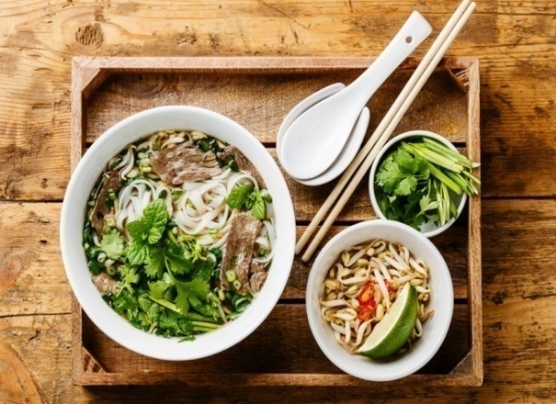
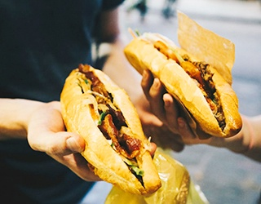
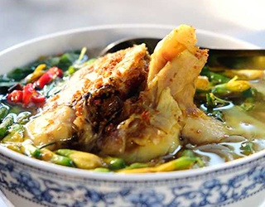
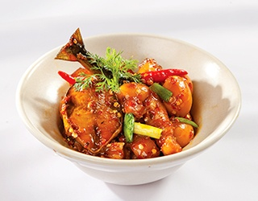
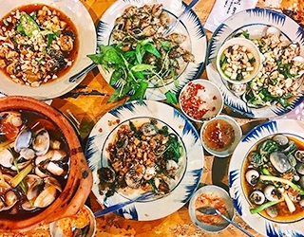
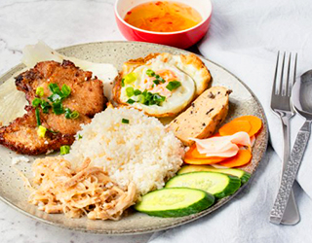
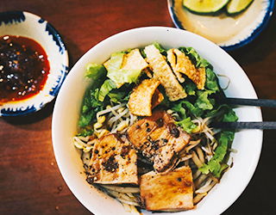
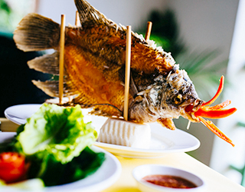
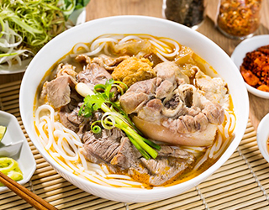
Best local cuisine in Vietnam for Family Tours
Pho (Noodle) – Hanoi
Banh Mi (Bread) – Hoi An
Bun Ca (Fish noodle soup) –
Mekong Delta
Ca Kho Gao – Ninh Binh
Oc – Ho Chi Minh
Com Tam – Ho Chi Minh
Cao Lau – Hoi An
Ca Tai Tuong (Elephant Ear Fish) – Mekong Delta
Bun Bo (Hue beef noodle soup) – Hue

Slide 21
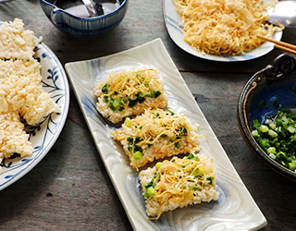
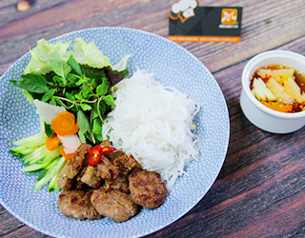
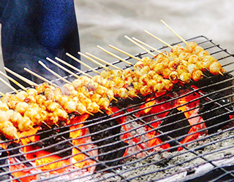
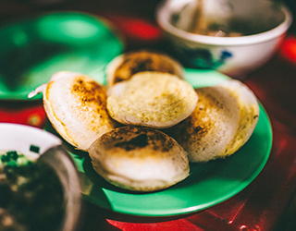
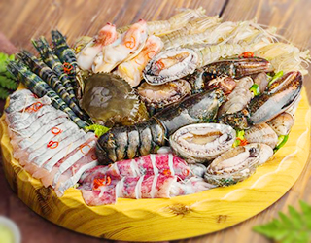
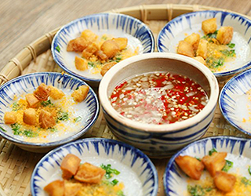
Com Chay (Burned rice) – Ninh Binh
Bun Cha - Hanoi
Rang Muc Nuong (Grilled squid teeth) – Mui Ne
Banh Can (Round rice cake) – Mui Ne
Seafood – Nha Trang
Banh Beo – Hue
https://www.trailsofindochina.com/

Slide 22

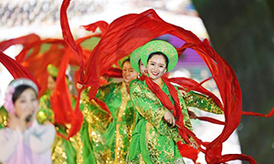

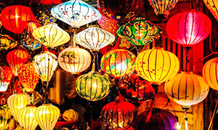
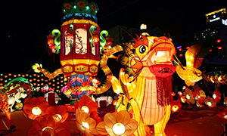
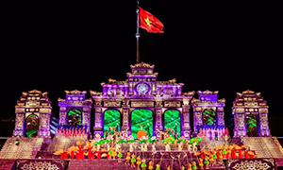
Local festivals & events for Family in Vietnam
Vietnam Lunar New Year
Halong Tourism Week (Halong Carnival)
Danang International Fireworks Competition
Hoi An Lantern Festival
Mid-Autumn's Festival
Hue Festival

Slide 23

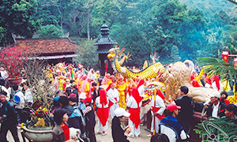
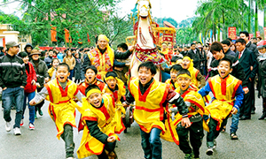
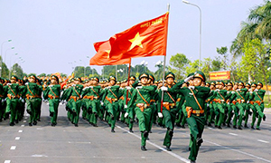
Dalat Flower Festival
Huong Pagoda Festival
Lim Festival
Independence Day

Slide 24
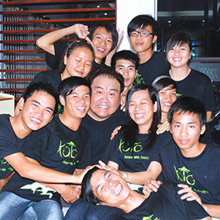
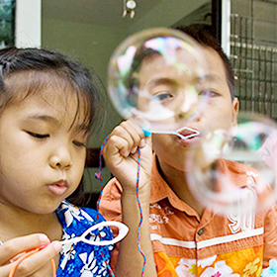
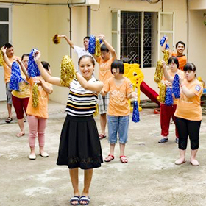
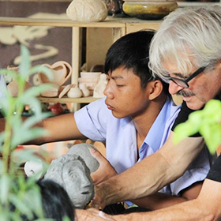
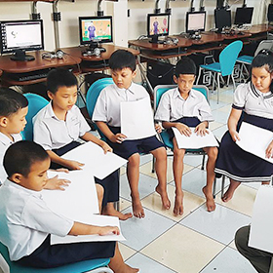
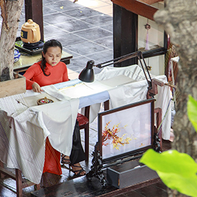
Local communities or non-profit organizations for Family in Vietnam
KOTO
SOS Orphan Village
Peace Children Village
Hope Center
Visually Impaired Pupils
XQ hand embroidery
Nguyen Dinh Chieu School

Slide 25
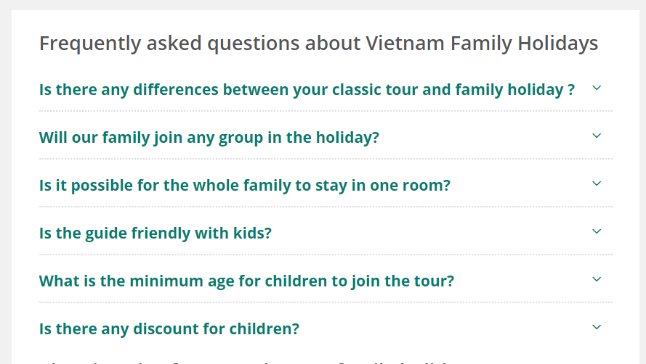
Most common questions Families Ask Us
Are particular outdoor activities safe for children?
Yes, those activities are suitable for children and operated with extreme care. Our tour guide will offer help to ensure your children's safety. First aid kids are prepared just in case.
KOTO
Will my children like food?
There is an enormous variety of food available in Vietnam, including Western food, fast food, vegetarian food and seafood. It is almost certain that there will be dishes your children like to eat. Our guides are experienced in helping select dishes they will like.
What's the accommodation like?
To ensure you enjoy good rest during the holiday, we carefully select family-friendly hotels, taking into consideration factors like Trip Advisor reviews, our previous customer feedback, location, availability of swimming pool and inter-connecting rooms, etc.
What is the best time for joining your family tours?
There is no restriction or set departure dates, you select the dates that work best for you. The weather will be decent from March to November. We can offer private customized tours based on your plan.
I have a large family, can you offer me some discount?
Sure! The more people in the group, the lower the price per person. It is a good opportunity to invite your relatives to get this offer.

Slide 26
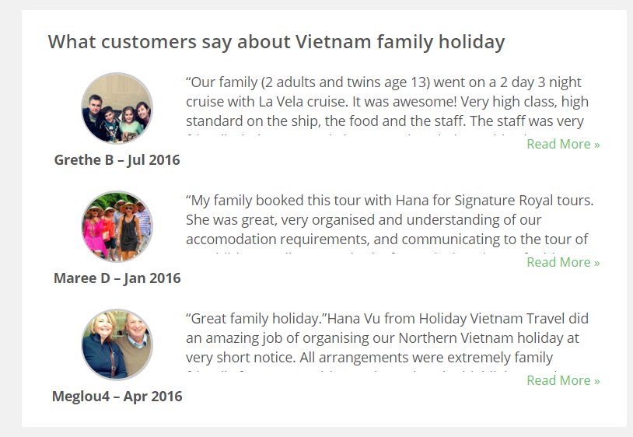
Awesome feedbacks from other families visiting Vietnam

